Slide 1
Joshua Bevers

Slide 2
What is this code?
An experiment in nested classes that brought untold pain later on. Never to be repeated.

Slide 3
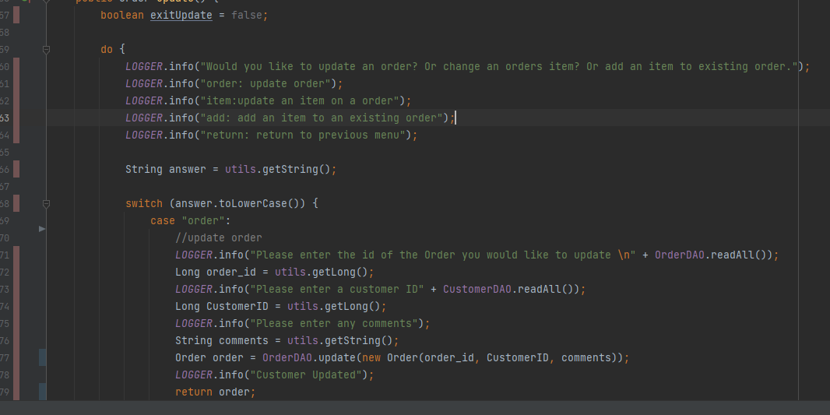
The Untold Pain

Slide 4
How to Fix
Creating a Domain for Order_Items, working off the CRUD used in the other domains.
Be more careful with do-whiles.

Slide 5
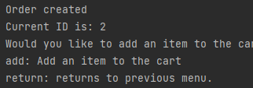
The good
The Do-whiles, while adding testing complexity, offer a better UX.
Allows for recursive commands to cut back on typing.

Slide 6
But I wasn’t happy…... And neither was Maven
At 4:13 pm Thursday, the day before the assignment was due, something happened. I’m still tracing back as to what, but Maven died. The project was split, unable to recognize unit test imports for the controller class, and spotty in other classes. It made no sense. I had lost an entire day’s work because I hadn’t committed on a regular schedule and lost track of time. The project was almost reset to square one.

Slide 7
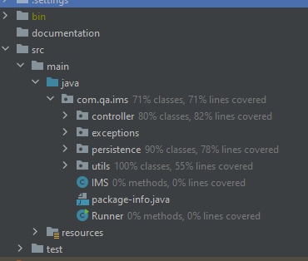

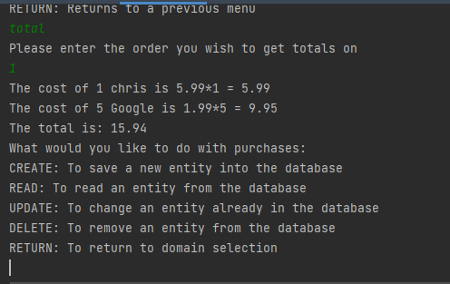
It was time for some action
I have to grind. It took a couple cups of coffee and some tired fingers, but we have a even better product at the end.

Slide 8
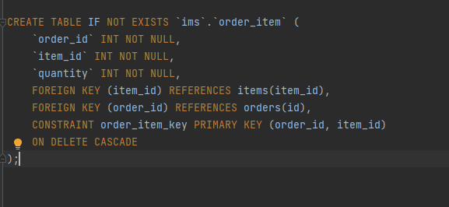
Neat Things About SQL
For this project, I didn’t put a auto_increment on it orders_item table!
Egads! The structure of
the world’s fabric is
coming undone!

Slide 9
We’re Fine
Actually, everything is fine. With the primary key being a composite of the foreign keys, it creates a pair. E.G 1-1 or 1-2 relation between the order id and item id. What this also gets us is that SQL will enforce uniqueness, which is great for us. We don’t want x number of orders with the same item of various quantities (we live in a land of instant transport). SQL will reject any attempts to add a non-unique pair and we can handle that inside the code.

Slide 10
Thank you!

